Slide 1

CNN based Object Detection
Reporter: WENHAO HE
Date: May 9th 2016

Slide 2
Outline
Review of my previous reports
You Only Look Once: Unified, Real-Time Object Detection
Synthetic Data for Text Localization in Natural Images

Slide 3
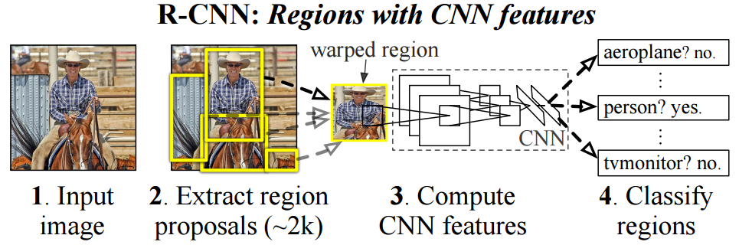
Previous Reports
Object detection (CNN based)
Proposal based
RCNN->SPP->Fast->Faster
Sliding window based
Densebox, YOLO, etc.

Slide 4
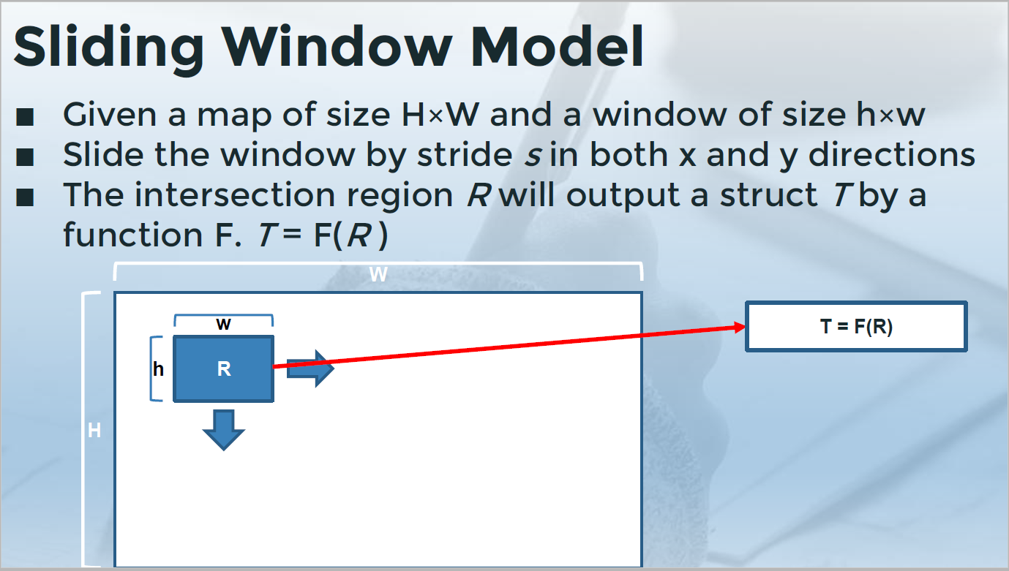
Previous Reports

Slide 5
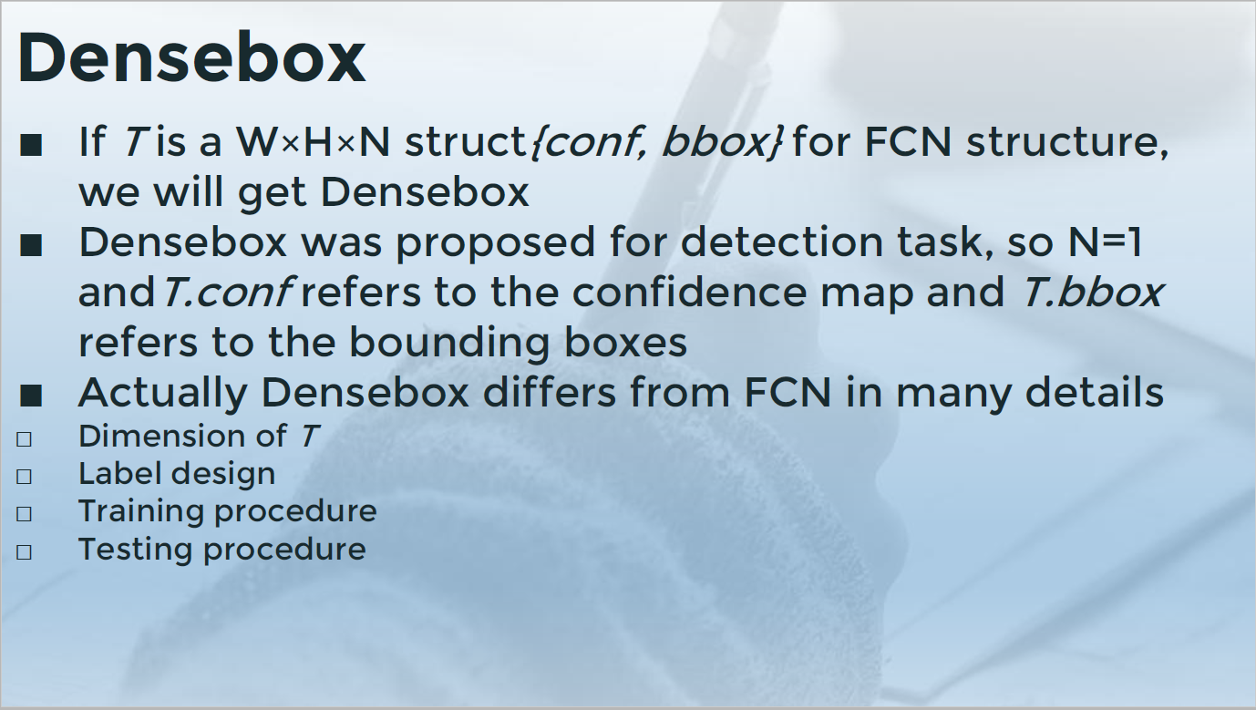
Previous Reports

Slide 6
YOLO
You Only Look Once: Unified, Real-Time Object Detection (8th Jun 2015)
Authors: Joseph Redmon, Santosh Divvala, Ross Girshick, Ali Farhadi
Ross Girshick: Facebook AI Research, rbg@fb.com
RCNN related models

Slide 7
YOLO
YOLO frames object detection as a regression problem to spatially separated bounding boxes and\associated class probabilities.
A single neural network predicts bounding boxes and class probabilities directly from full images in one evaluation.

Slide 8
YOLO
Our system divides the input image into a S×S grid. If the center of an object falls into a grid cell, that grid cell is responsible for detecting that object.
Each grid cell predicts B bounding boxes and confidence scores for those boxes
Each bounding box consists of 5 predictions: x, y, w, h, confidence
Each grid cell also predicts C conditional class probabilities
At test time we multiply the conditional class probabilities and the individual box confidence predictions

Slide 9
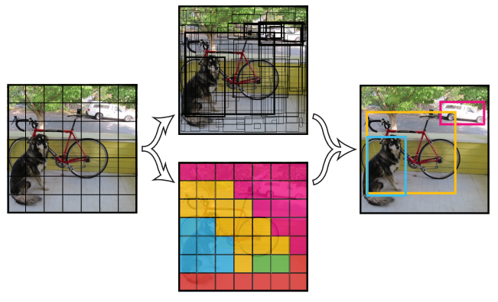
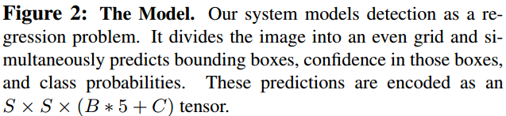
YOLO
For Pascal VOC S=7, B=2, C=20
Final prediction is a 7×7×30 tensor
The input image is 224×224, so the CNN has 5 down-sampling layers

Slide 10
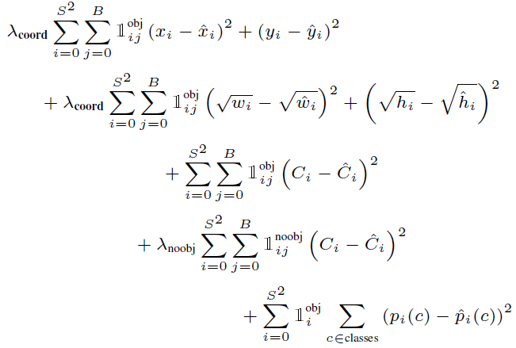
YOLO
remedies for task balancing, remedies for class unbalance
denotes if object appears in cell i and denotes that the jth bounding box predictor in cell i is “responsible” for that prediction
Why predict B boxes?
Each predictor gets better at predicting certain sizes, aspect ratios, or classes of object

Slide 11
YOLO
Limitations
It struggles with small objects that appear in groups (like text)
It struggles to generalize to objects in new or unusual aspect ratios or configurations (like text)
A small error in a large box is generally benign but a small error in a small box has a much greater effect on IOU. Our main source of error is incorrect localizations.

Slide 12
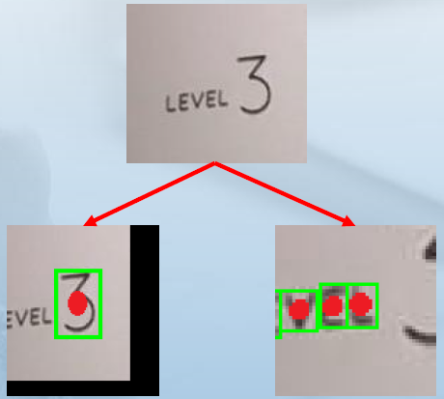
YOLO
Compared with Densebox
Remove RoI sampling
Loss function: YOLO chooses pure regression design
Multi-scale is not needed in YOLO, but not suitable for text detection

Slide 13
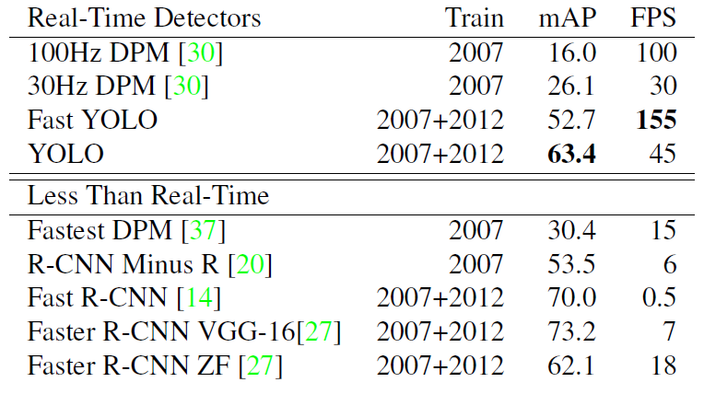
YOLO
Result

Slide 14
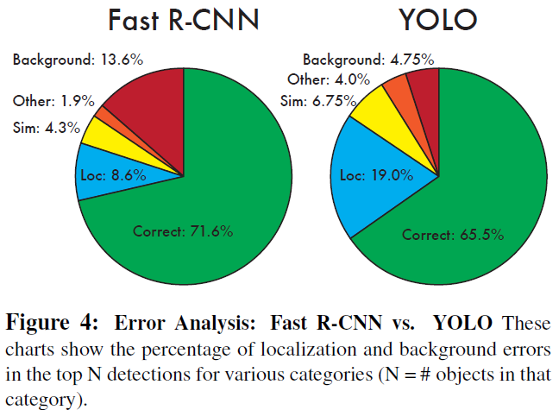
YOLO
Error analysis

Slide 15
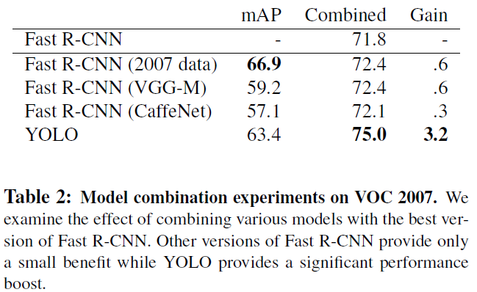
YOLO
Combining Fast RCNN and YOLO
For every bounding box that R-CNN predicts we check to see if YOLO predicts a similar box. If it does, we give that prediction a boost based on the probability predicted by YOLO and the overlap between the two boxes

Slide 16
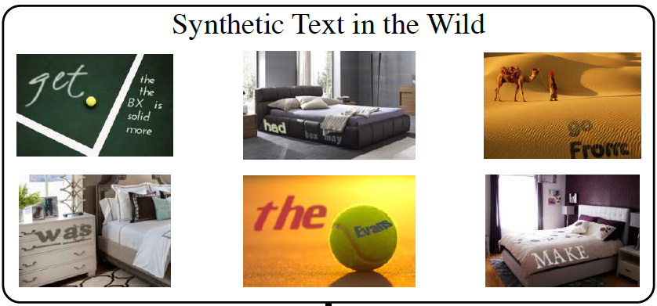
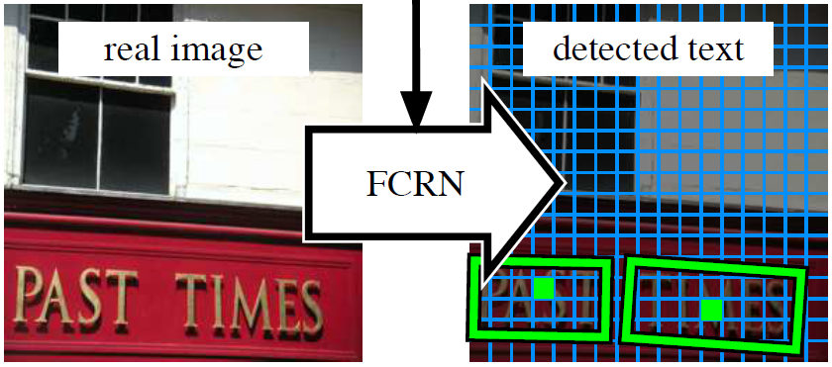
Synthetic Data for Text Localization in Natural Images
Ankush Gupta, Andrea Vedaldi, Andrew Zisserman
Dept. of Engineering Science, University of Oxford
Zisserman is an ISI Highly Cited researcher. He is the only person to have been awarded the Marr Prize three times, in 1993, in 1998, and in 2003. He was elected Fellow of the Royal Society in 2007. In 2008 he was awarded BMVA Distinguished Fellowship. In 2013 he received the prestigious Distinguished Researcher Award at ICCV.

Slide 17
Synthetic Data for Text Localization in Natural Images
A fast and scalable engine to generate synthetic images of text in clutter
We use the synthetic images to train a Fully-Convolutional Regression Network (FCRN) which efficiently performs text detection and bounding-box regression at all locations and multiple scales in an image

Slide 18
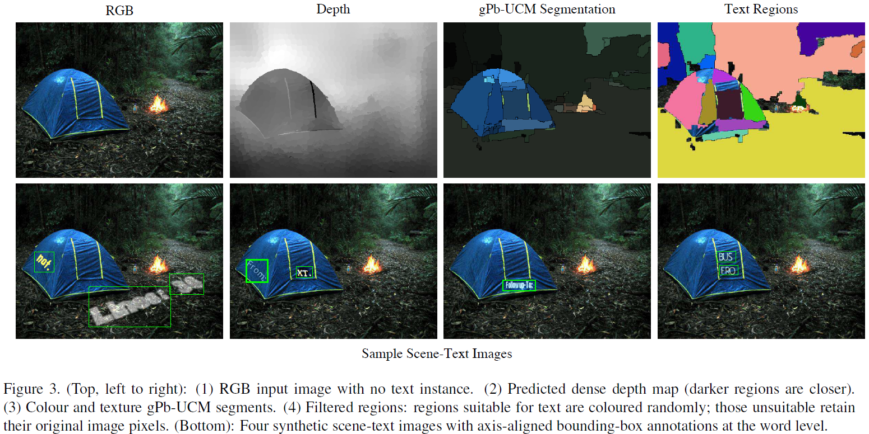
Synthetic Data for Text Localization in Natural Images

Slide 19
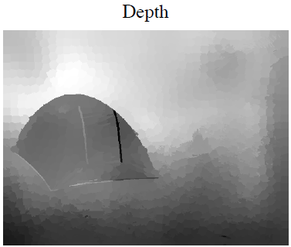
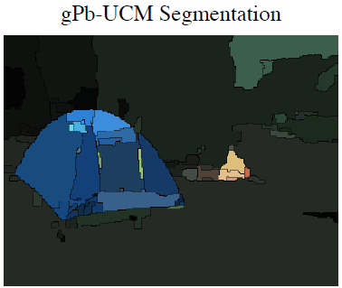
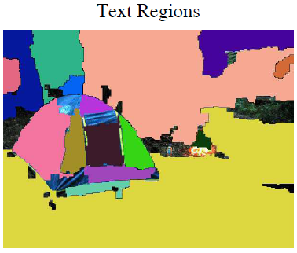
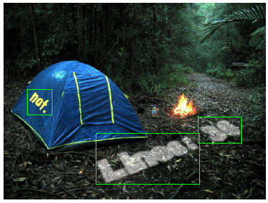
Synthetic Data for Text Localization in Natural Images
Depth: Deep convolutional neural fields for depth estimation from a single image (CVPR 15)
Regions: Contour detection and hierarchical image segmentation (PAMI 11)
Cut: Multi-scale combinatorial grouping (CVPR 14)
Alignment:
The image region contour is warped to a frontal-parallel view using the estimated plane normal
A rectangle is fitted to the frontal-parallel region
The text is aligned to the larger side (“width”) of this rectangle

Slide 20
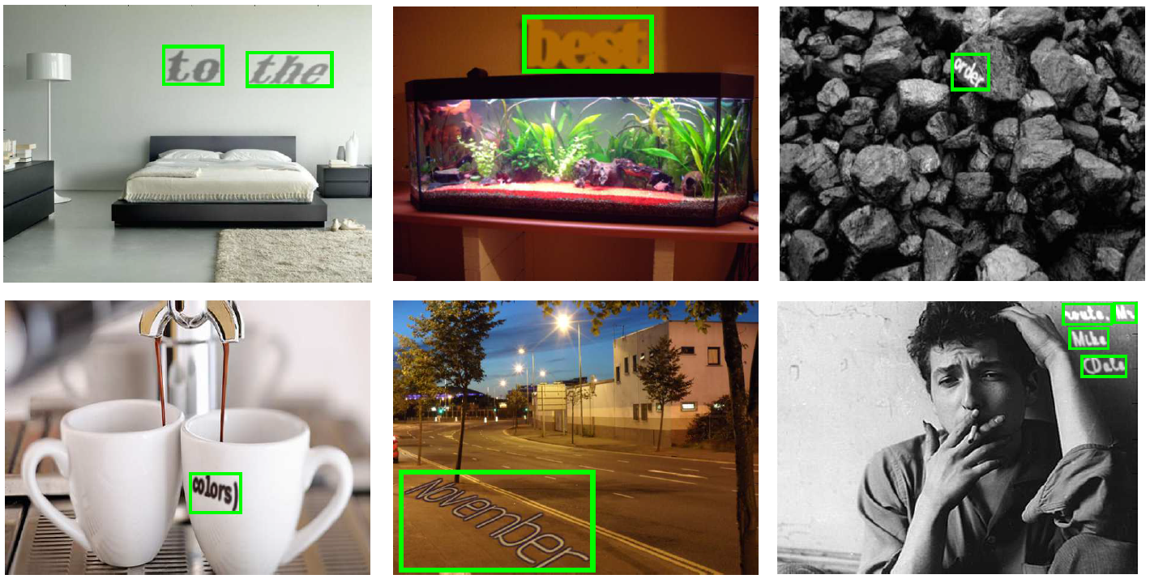
Synthetic Data for Text Localization in Natural Images
Some synthetic samples

Slide 21
Synthetic Data for Text Localization in Natural Images
Construct a fixed field of predictors (c,p) = ψ_{uv}(x), each of which specializes in predicting the presence c∈R and pose p = (x-u, y-v, w, h, cosθ, sinθ) of an object around a specific image location (u, v)
In practice, for a 224×224 image, we obtain 14×14 cells/predictors (This doubles the resolution of YOLO)
Limited receptive field of our convolutional filters prohibits detection of large text instances. Hence, we get the detections at multiple down-scaled versions of the input image and merge them through NMS
The resulting detections are combined by suppressing those with a lower score than the score of an overlapping detection
We use a squared loss term for each of the7 outputs of the CNN as in YOLO. If a cell does not contain a ground-truth word, the loss ignores all parameters but c (text/no-text)

Slide 22
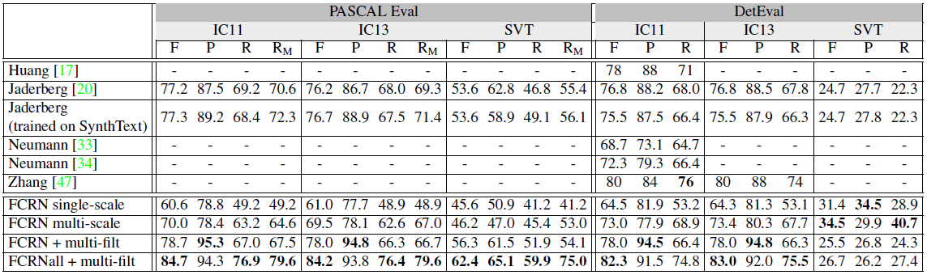
Synthetic Data for Text Localization in Natural Images
Result
Single-scale
Multi-scale
Multi-scale + Post-filtering
Multi-scale + Post-filtering + low recall
The result is not ideal if not adopting post processing

Slide 23
Synthetic Data for Text Localization in Natural Images
Generate synthetic data through an elegant way instead of adopting 3D engine
To detect text, seeing too much context may not be useful, in this paper, the author use a much smaller model rather than the popularized VGG-16
Multi-scale fusing is an essential step for text detection
The text line aspect ratio varies a lot, detect the whole text line may not be a wise choice
The raw results without post process are actually not ideal in this paper
Most work on text detection still focuses on origin FCN and this structure hinders more delicate processing like Densebox, YOLO and FCRN

Slide 24
THANKS!
Any questions?

